Slide 1


Slide 2

Engineering Security Solutions
Ransomware – Rollback Remediation
Donnacha Forde

Slide 3













$whoami
About
Mostly Finance (~10yrs)
Security
(>8 yrs)
Mostly Systems-Management (~15yrs)
Developer
Architect
Manager
Technical Director

Slide 4
Agenda
Context & Background
Innovation
Engineering
Endpoint Protection
Ransomware trends.
Determining a strategy
Rollback Remediation
Explore Mechanics
Lateral Movement
Behavioural Analysis
Understanding the drivers
How AV works
Options considered
Process Genealogy
Agile Practices
Performance Engineering
Fileless Remediation?

Slide 5
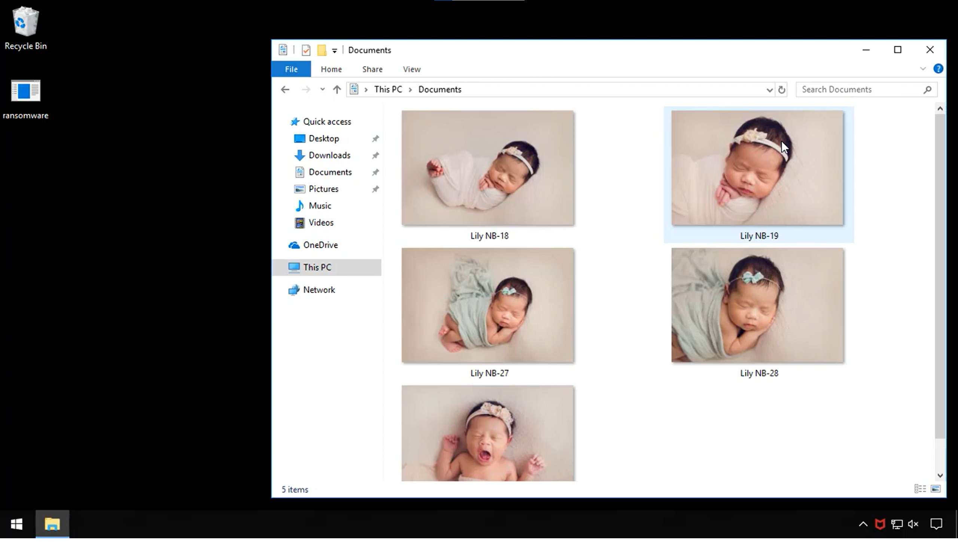
Demo
https://www.youtube.com/watch?v=OwJSZT2U4kM

Slide 6
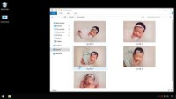

Slide 7
The Problem – Ransomware
A look at Ransomware Trends

Slide 8
Timeline
2015
Anti-ransomware research
2016
Engineering PoC
MVP complete
2018
2019
2017
MVISION Endpoint
ENS 10.7

Slide 9
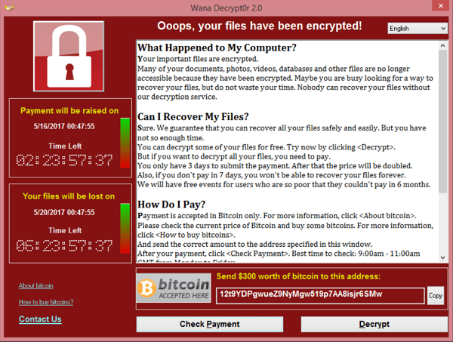
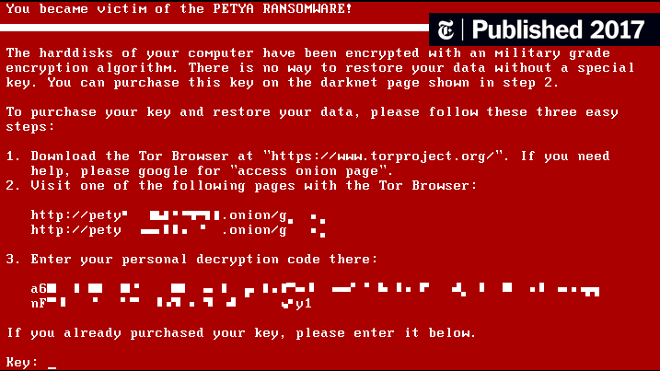
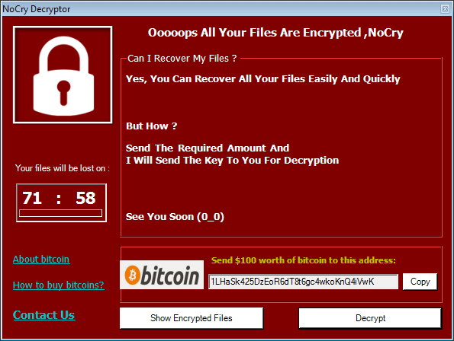
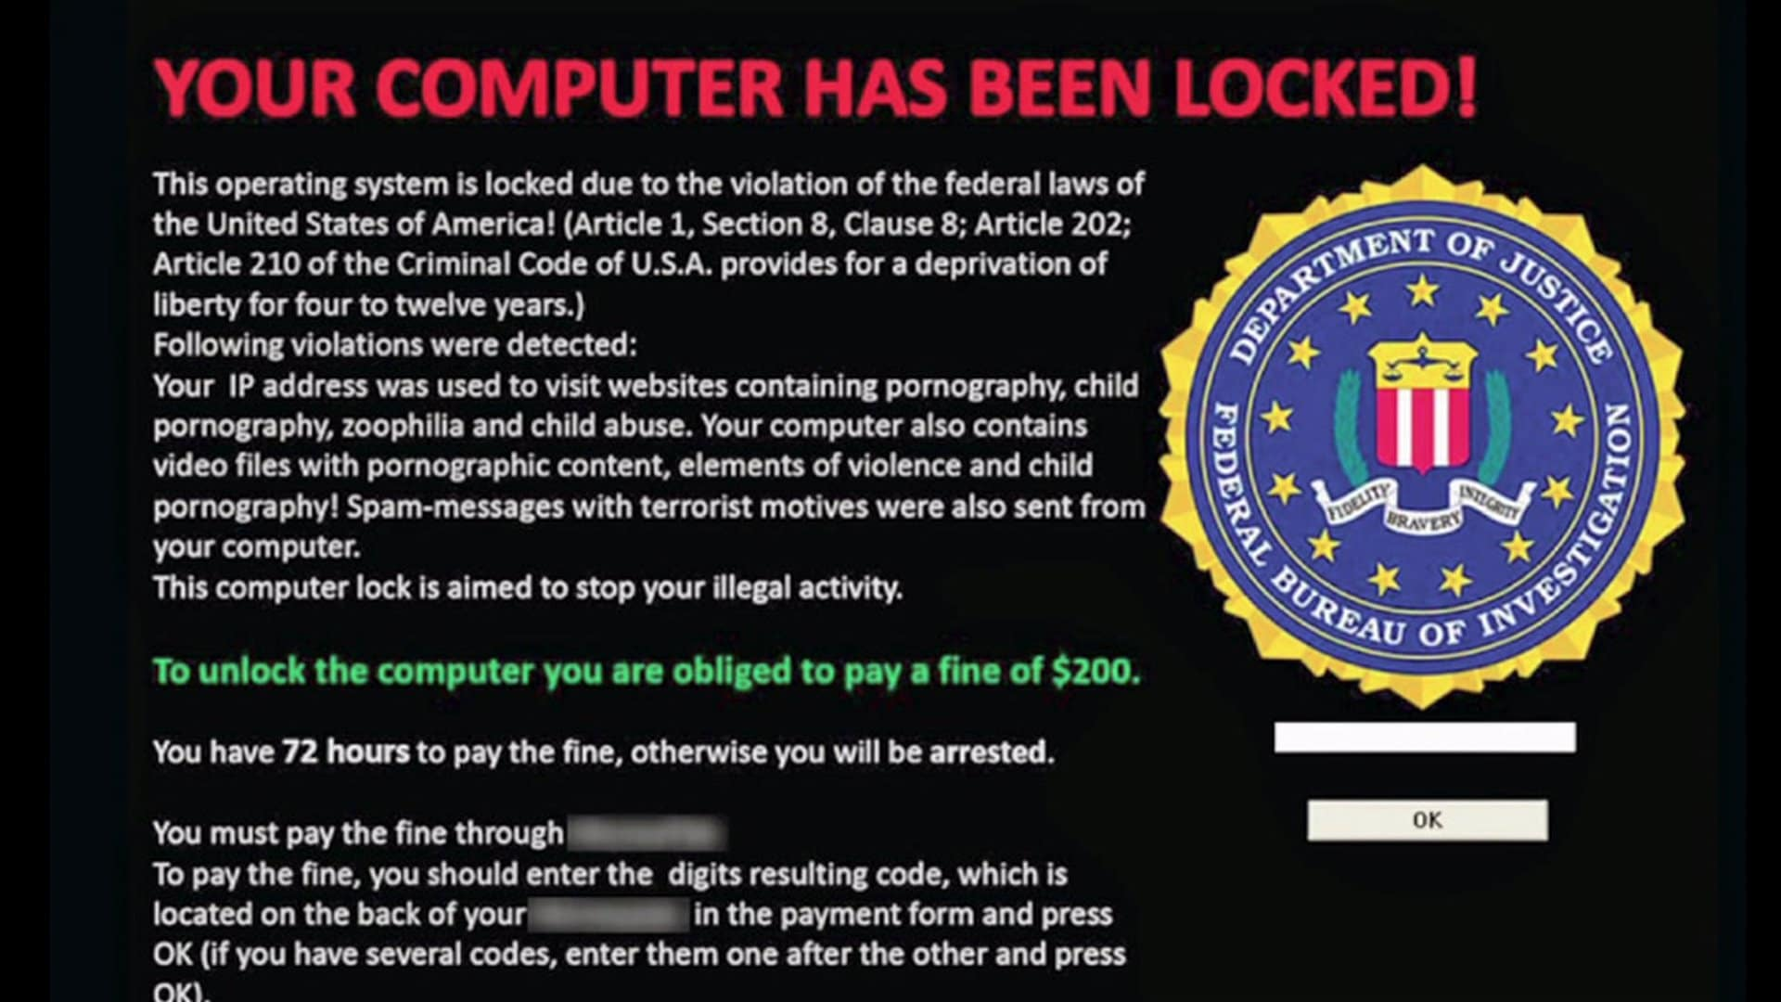
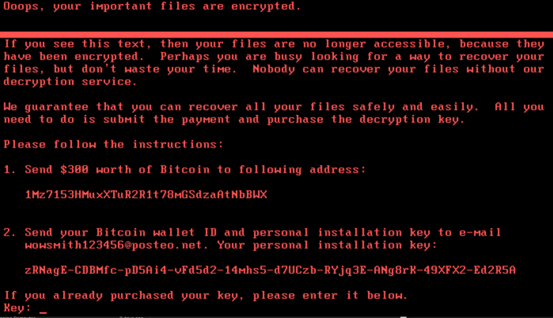
Circa 2016
Top 10 Worst Ransomware Attacks
NotPetya
WannaCry
Locky
CrySis
Nemucod
Jaff
Spora
Cerber
Cryptomix
Jigsaw

Slide 10
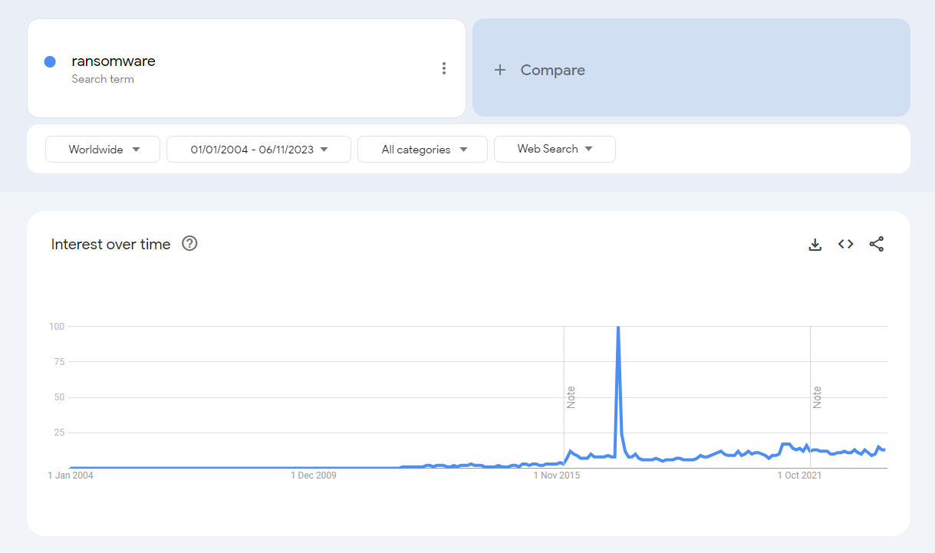

Slide 11
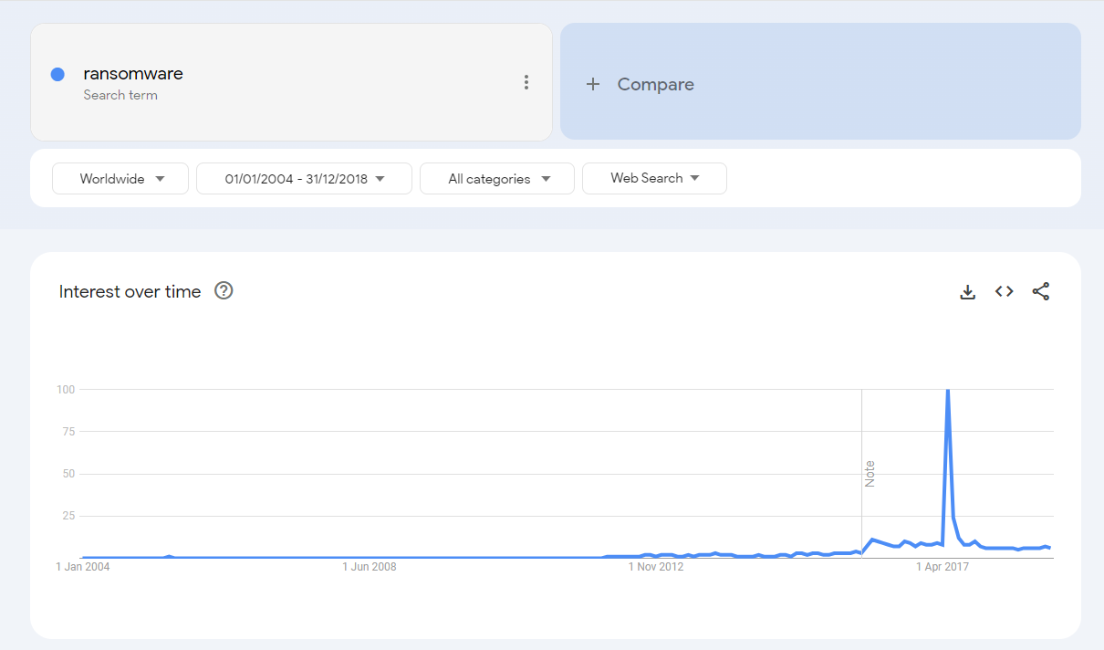
July 2017
WannaCry
Petya
NotPetya
Internal Showcase
R&D Commences

Slide 12


Slide 13
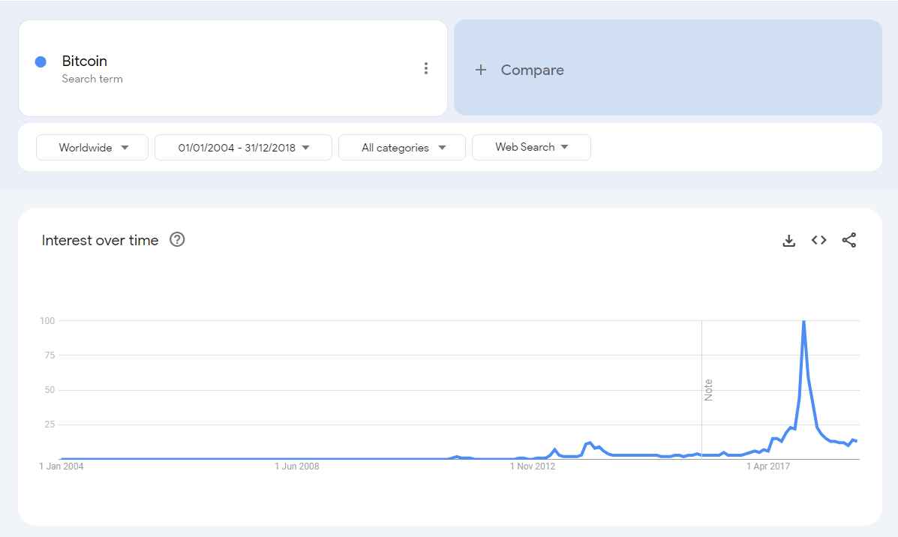

Slide 14
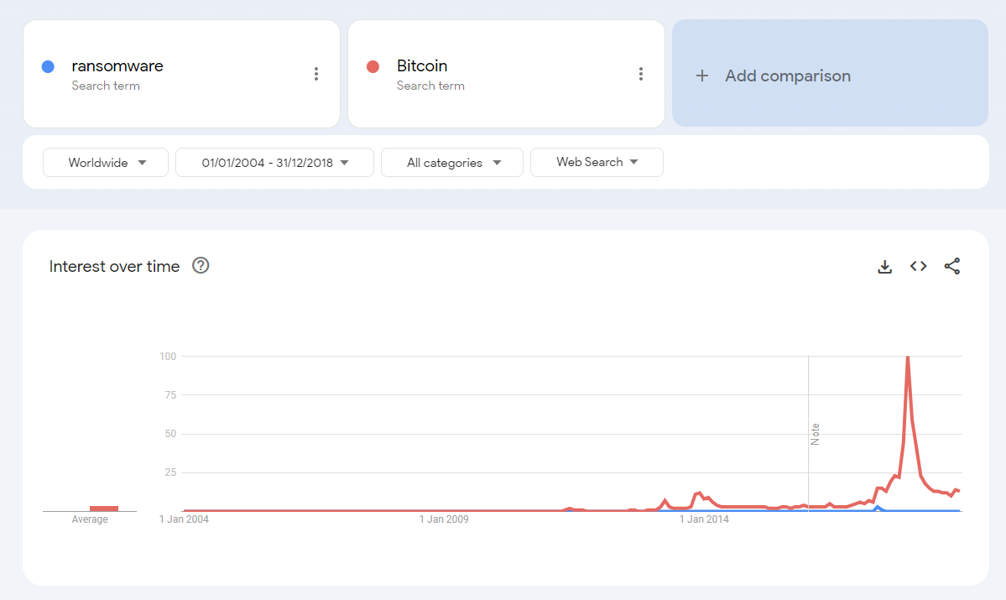

Slide 15
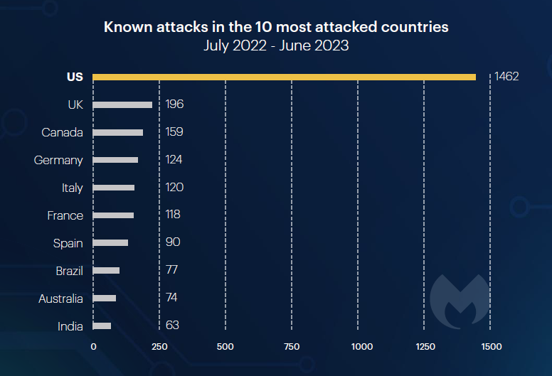
Ransomware continues to be a Threat
US is the most attacked country.
Image Credit: Malwarebytes – State of Ransomware Report 2023

Slide 16
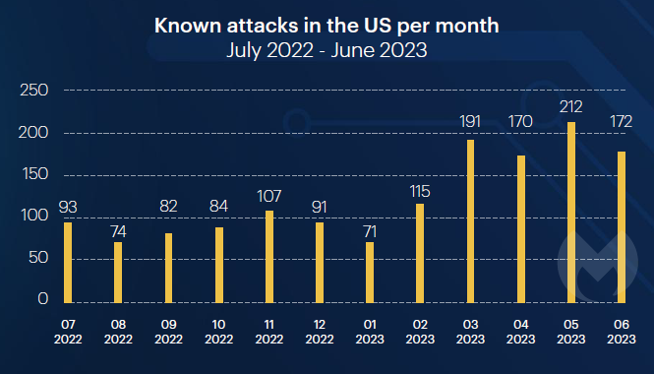
Ransomware continues to be a Threat
Ransomware attacks in last 12 months.
Image Credit: Malwarebytes – State of Ransomware Report 2023

Slide 17
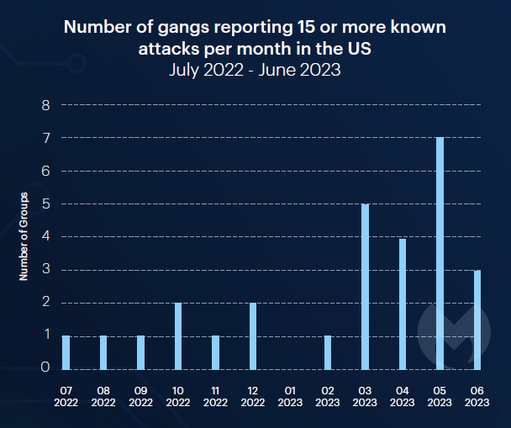
Ransomware continues to be a Threat
Active gangs
Image Credit: Malwarebytes – State of Ransomware Report 2023

Slide 18
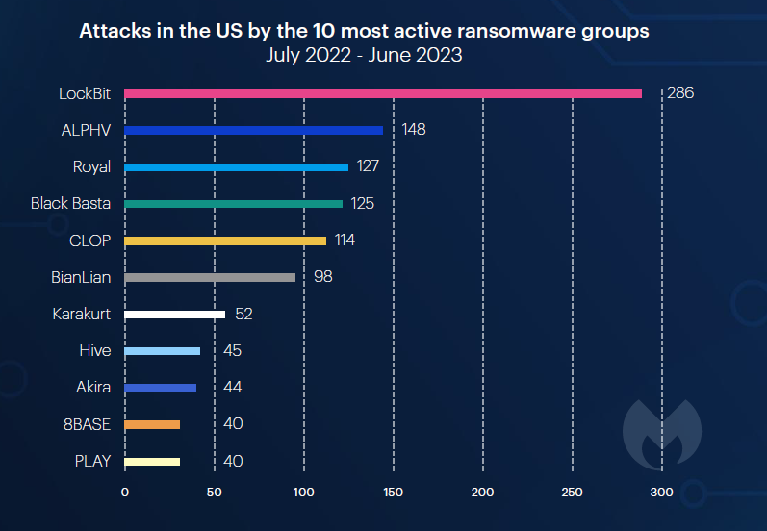
Ransomware continues to be a Threat
Ransomware Gangs
Image Credit: Malwarebytes – State of Ransomware Report 2023

Slide 19
Context – How AV Works
Typical Endpoint Antimalware

Slide 20

How AV works
Binary Started
Startup Interrupted
File & Process Interrogated
Certs
Characteristics
Monitoring & Tracing
Process allowed to execute
Process Injection (for monitoring)
Validate Trust
Signed ✓
Determination
Rules Engine
ML
AI?
Embryonic Process
Patterns (Various Strategies)
Apply Rules (Static*)
Local/Remote Processing
Process Hooking (for self-protection)
Kernel-based
Check signature
Known Good/Bad
Calculate File Hash
Tread carefully… & don’t generate I/O.
Watch…
Can still convict here…
Low-level OS kernel (privileged access)
Go to work.
Apply ‘scanners’…
Damage can be done from here!

Slide 21
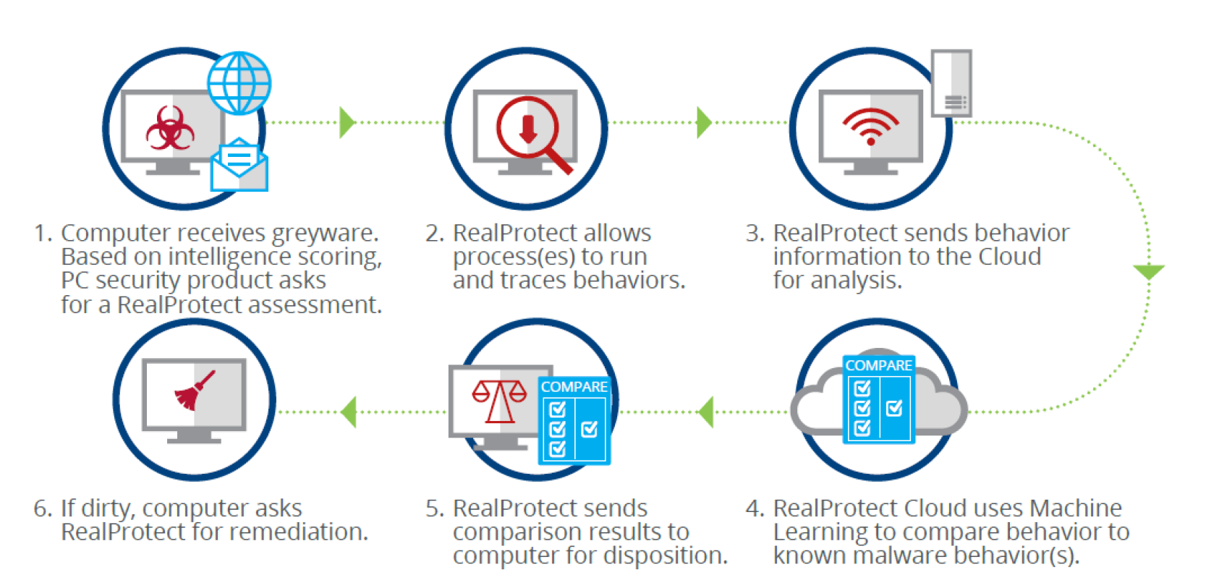
McAfee Behavioural Analysis
Image Credit: McAfee Whitepaper – You, Machine Learning & Zero-Day Malware

Slide 22
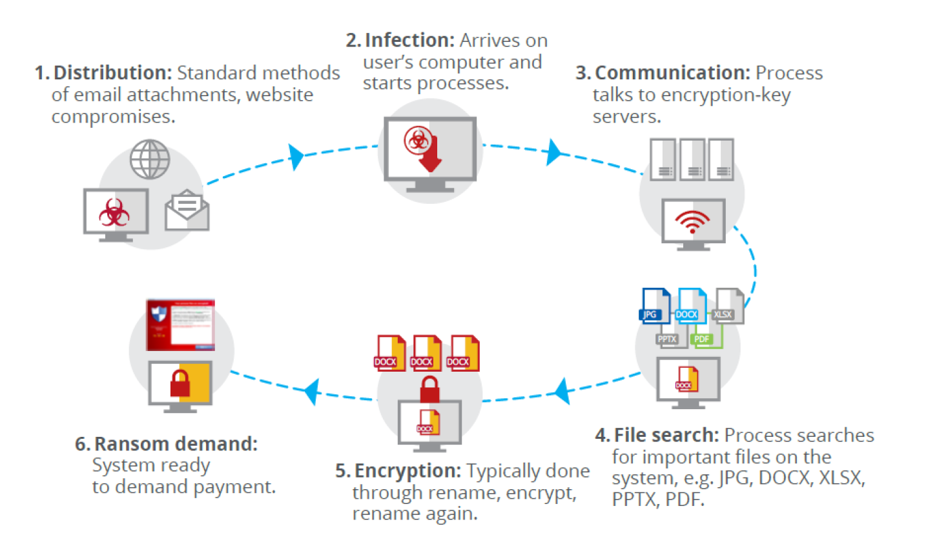
How Ransomware Works
Image Credit: McAfee Whitepaper – You, Machine Learning & Zero-Day Malware

Slide 23
How Ransomware Works
Iterate over the File System
Pseudo Code
What’s the Problem?
Open File System
Open Directory
Read File
Write Encrypted File
Delete Original
Loop
Loop
Zero-day!
Dir
Dir
File
File
File
File
File
*Focus on typical document locations
*Target office docs

Slide 24
Innovation
Devising an Anti-ransomware Solution

Slide 25
Strategies
Prevention
Block Malware
Zero-day Ransomware?
Polymorphic Malware?
Avoidance
Cloud Storage
(e.g. Microsoft OneDrive)
Minimize impact → Restore to last known-good backup
Incur re-image cost & effort
Remediate
Restore Endpoint to previous known-good state

Slide 26

Getting the balance right
Considerations
Facilitate Evaluation
Endpoint Protection
User Convenience
Allow user to run ‘unknown’ executables
Allow time for deliberation
Facilitate Revelation
Allow malware to reveal itself
Protect the user

Slide 27

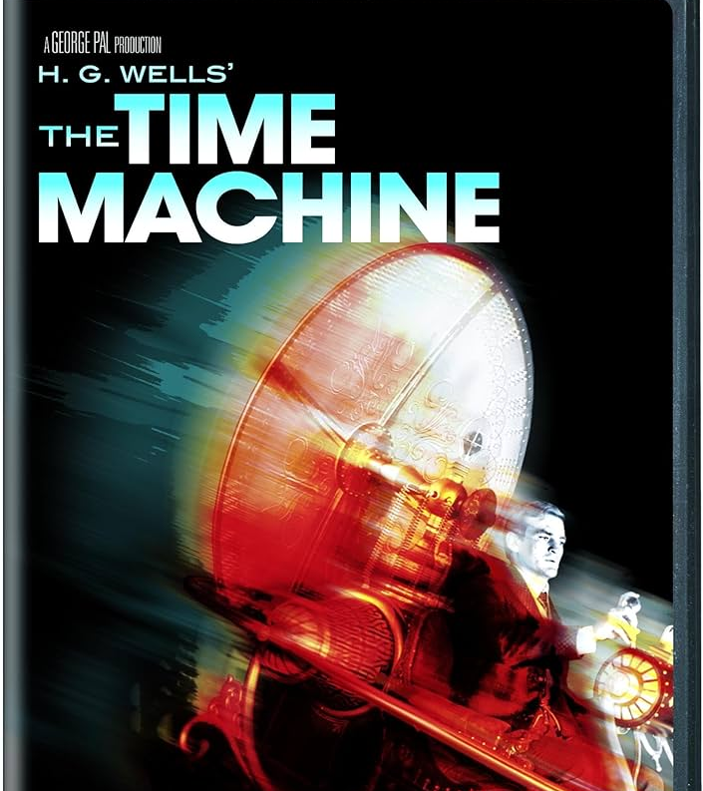
Remediation Strategies
Confinement
Limit damage to a Virtual Image
Ditch VM on conviction
Roll forward if not convicted
Rollback Reversal
Perfect Undo
Rollback on conviction
Do nothing if not convicted

Slide 28
Remediation Strategies
Optimistic v Pessimistic View
Roll forwards – or – Roll backwards
Most software != malware
Fewer instances where we need to take action → Roll backwards

Slide 29
Rollback Remediation
What is it? How does it work?

Slide 30
Rollback Remediation
Before Conviction
Monitor
Create Backups
Post Conviction
Kill Process Tree
Restore

Slide 31
Rollback Remediation
Correction Technology Does not detect
Does not protect
Passively Monitors Performs Low-level Monitoring
Maintains ‘Process Genealogy’ Tree
Active Monitoring Triggered Records detailed activity
Maintains copies of File, Directory and Registry changes. Monitors child processes, proxies or any other surrogates.
Remediates Terminates Process Tree Uses Logs to restore all File, Directory & Registry changes & perform rollback.

Slide 32
Remediation Details
File & Directory
Files & Directories restored to original state.
Encrypted files removed.
‘Dropped files’ removed.
Windows Registry
RegKeys & Values restored to original state.
Created RegKeys & Values removed.
File Attributes
Security Descriptors
Preserve file security metadata.
Restore File/Directory ownership.
Preserve Hidden/Archive file attributes.
RunKeys & Startup Directories
Clean autostart registrations.
Clean known (and not-so-well known) directory & registry locations.

Slide 33
Detecting Lateral Movement
Windows Service Control Manager
Registration of background Windows Services (Daemons).
Windows Task Scheduler
Remove tasks scheduled for future execution.
Windows BITS
Background Intelligent Transfer Service
Facilitate intelligent file download
Download failure triggers registered handler.

Slide 34



Detecting Lateral Movement
1221
1243
6569
2987
9875
345
657
5976
1275
9858
Service Control Manager

Slide 35
Engineering
Building Solutions for GA

Slide 36
Engineering Practices
Agile/Scrum
Daily Standup
2-week Sprint
6-week PSI (Potentially Shippable Increment)
End-of-Sprint Demo
Sprint Planning
Proxy Product Owner
Test Driven Development
Pair Engineers with SDET
Automated Functional Tests
Integrated into build
1000+ Test Cases
Continuous Build
Daily/Weekly/On-demand (PR)
Integrated Tests
Virus Labs
Test against specific Malware
Remediate Top-10 Ransomware

Slide 37
Performance Engineering
Ensuring ‘cost’ is within bounds

Slide 38
Performance Engineering
Endpoint is ‘highly’ sensitive to resource utilization
EPP should be in the background
Public Tests rule the day
AV-TEST
AV-Comparisons
Operation imperceptible to the user
Active monitoring costs
e.g. File copies

Slide 39
Performance Engineering
Real-world Scenarios
Quantitative Loads
User Profile
Define typical profiles for light, medium & heavy users
Windows ADK
Install Browser
Install LibreOffice
Uncompress operation
Determine if performance is linear or potentially exponential
Variables = No. of Files, Size/Type of Files, Directory depth/breath
Scientific Approach – i.e. modify 1 variable at a time.
e.g. Browsing & Streaming, MS Office user, Software Engineer
Internal Standard
Common Use-cases
(e.g. browser load, application launch, boot-up, restart, etc.)

Slide 40
Performance Engineering
Manage Performance Metrics
Performance Trends
CI/CT
Track performance data over time.
Capture & Store performance data
Graphically display results
Determine general improvements
Capture anomalies/outliers
Continuous Testing
Integrated into build
Hourly/daily/weekly builds
Show trend

Slide 41
Conclusion

Slide 42
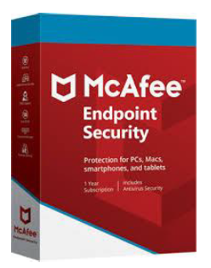

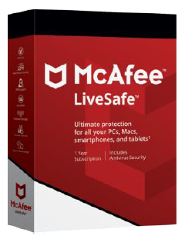
Integration Timeline
2018
2019
MVISION Endpoint
ENS 10.7
2020
Consumer
>100K Endpoints
>11M Endpoints
~150M Endpoints

Slide 43
Conclusion
Ransomware Trends
How AV works
Innovation Journey
Further Innovation…
Engineering a Rollback Remediation solutions

Slide 44
Potential Innovations
Deep Monitor ‘Greyware’
Track low-level operation of Malware AND Goodware
Big Data → Machine Learning → AI

Slide 45
Q&A

Slide 46
Thank you

Slide 48
Fileless Remediation
Breaking the Execution Chain

Slide 49
Normal AV
Detect Malware →Terminate Process
Move Binary File to Quarantine
No Further Threat

Slide 50
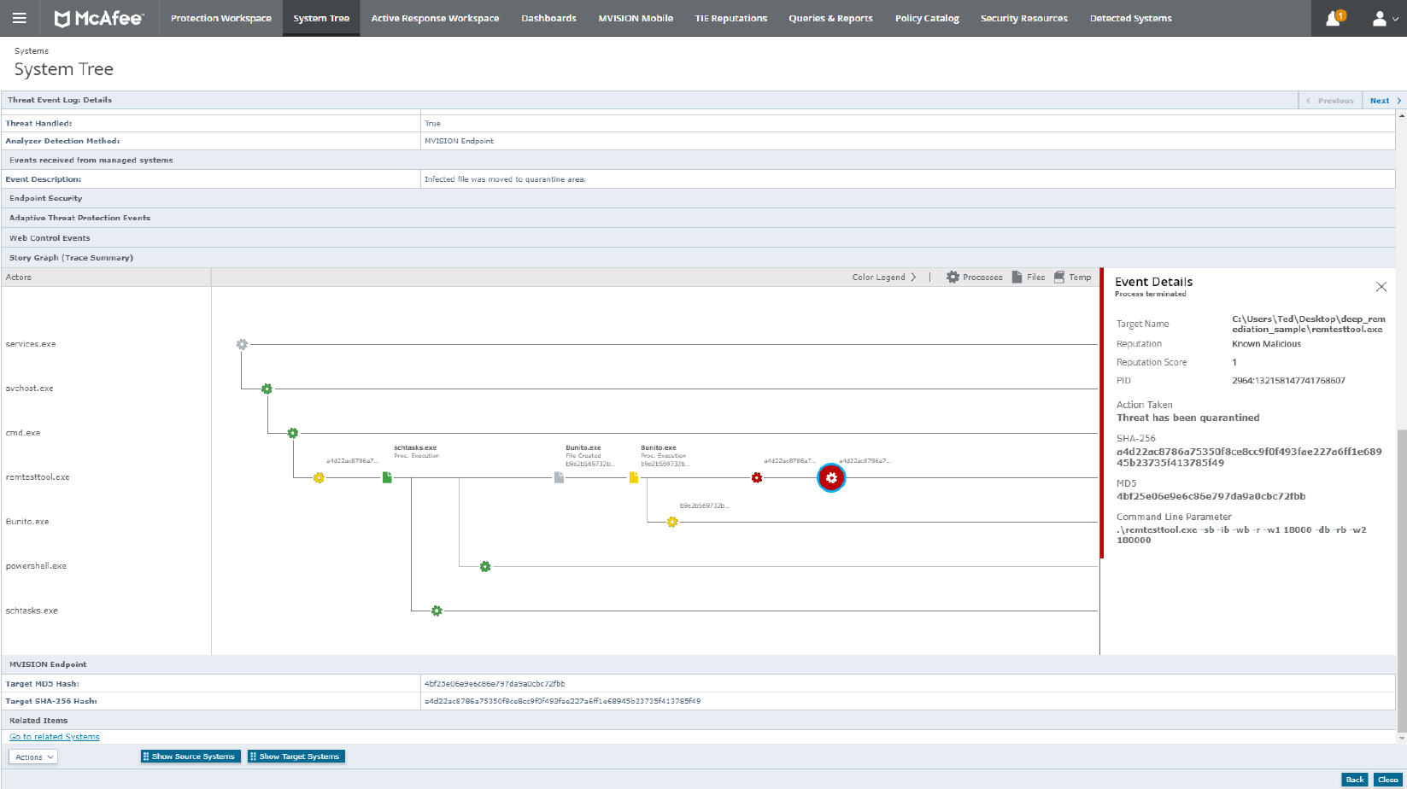

Slide 51
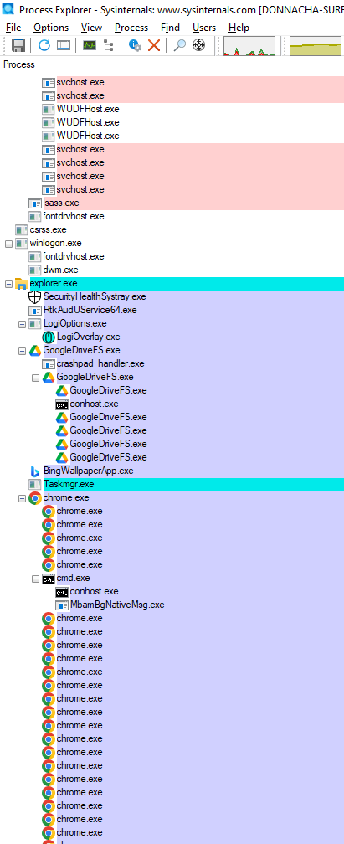
Process Tree Hierarchy

Slide 52


Passive Monitoring
Active Monitoring
Fileless Remediation
Enhanced Remediation
1221
1243
6569
2987
9875
345
657
5976
654
1275
3625
9858
7458
4586
989
6958
2365
2858

Slide 54
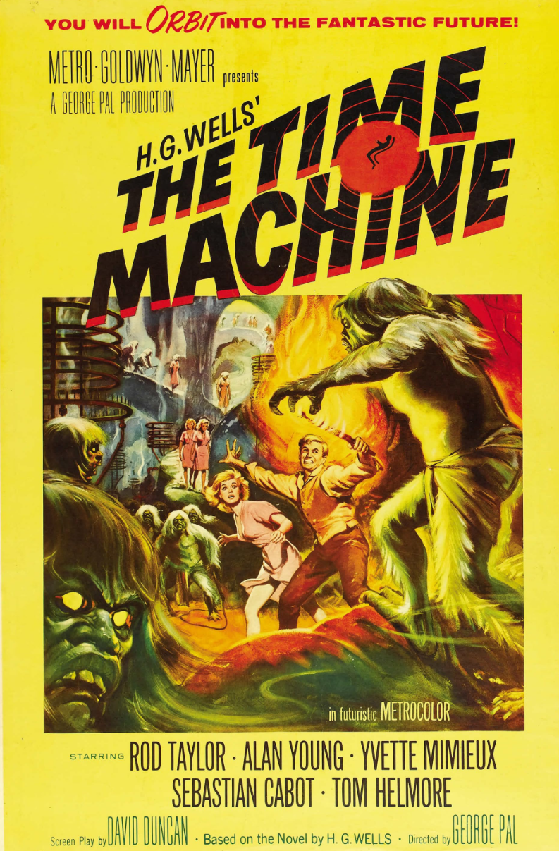

Slide 55
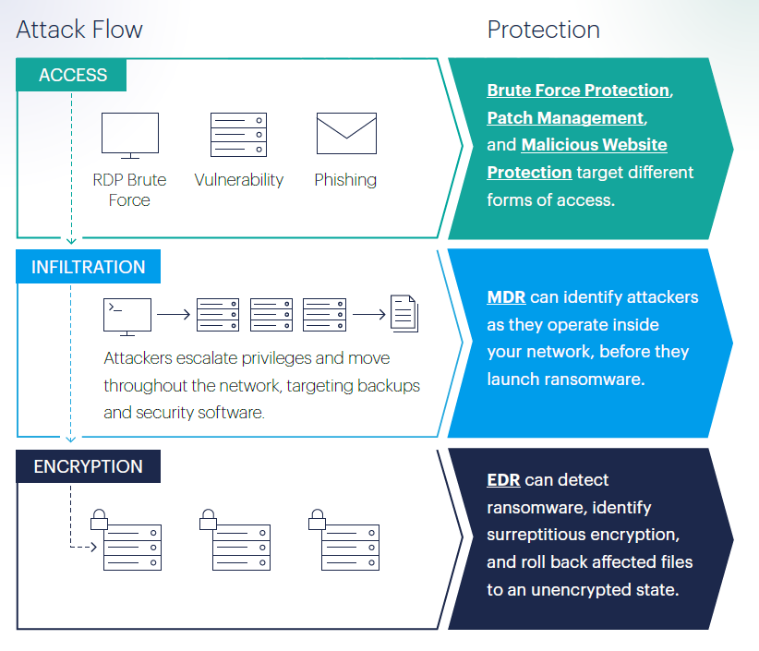
How Ransomware Works
Image Credit: Malwarebytes – State of Ransomware Report 2023

